Slide 1
Conditional Structures
Computer Organization and Assembly Language
Computer Science Department
National University of Computer and Emerging Sciences Islamabad

Slide 2
Agenda for today
Arithmetic Instructions
Labels
Conditional and Unconditional Flow of Program
JMP instruction
Loops

Slide 3
Arithmetic Instructions
MUL operand1
operand1 is 8-bit (type BYTE): multiply with contents placed in register AL, result will be in AX.
operand1 is 16-bit (type WORD): multiply with contents placed in register AX, result will be in DX:AX.
operand1 is 32-bit (type DWORD): multiply with contents placed in register DX:AX, result will be in EDX:EAX.
Example
MOV AL, 200 ;
MOV BL, 4
MUL BL ;

Slide 4
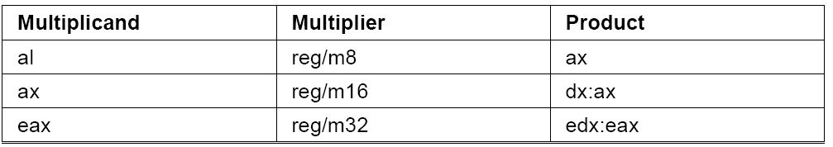
MUL Instruction

Slide 5
Arithmetic Instructions
DIV operand1
when operand is a BYTE: AL = AX / operand then
AL =Quotient
AH = remainder
Example
MOV AX, 203;
MOV BL, 4;
DIV BL ; AL = 50 , AH = 3

Slide 6
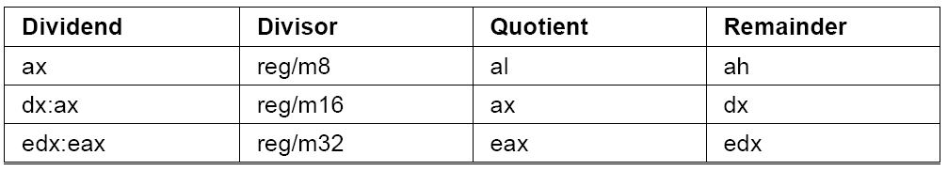
DIV Instruction
when operand is a word: AX = (DX AX) / operand then
AX = Quotient
DX = remainder

Slide 7
Divide overflow
If a division operand produces quotient that is larger than storage then divide overflow condition occurs and the program terminates.
MOV AX,1000h
MOV BL, 10h
DIV BL ;AL cannot hold 100h
Similarly when you divide by zero program terminates.

Slide 8
Labels in Assembly
A label is an identifier that is followed by a colon.
Names suffixed with colons (:) are symbolic labels.
The labels do not create code.
They are simply a way to tell the assembler that those locations have symbolic names.
Example
Label1:
Above:
Start:

Slide 9
JMP Instruction
Unconditional jump
Jumps to the given label[Address]
Syntax:
JMP [Label] ;PC will jump to the address of Label

Slide 10
Examples
Backward jump
StartLoop:
; statements
JMP StartLoop
Forward jump
JMP EndLoop
; statements
EndLoop:

Slide 11
Conditional Jumps
Transfers Control if condition is satisfied.
Jumps based on unsigned data
Jumps to label if equal
JE [label]
Jump if not equal
JNE [label]

Slide 12
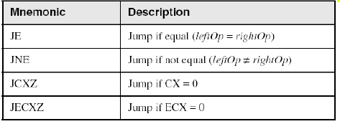
Jumps Based on Equality
Notes:
ZF=1 ZF=0

Slide 13
CMP Instruction
Compares value of two operands and set flags
Syntax
CMP opr1,opr2
Opr1 = reg/mem
Opr2 = reg/mem/imme
Example
CMP ax,bx
CMP ah,al

Slide 14
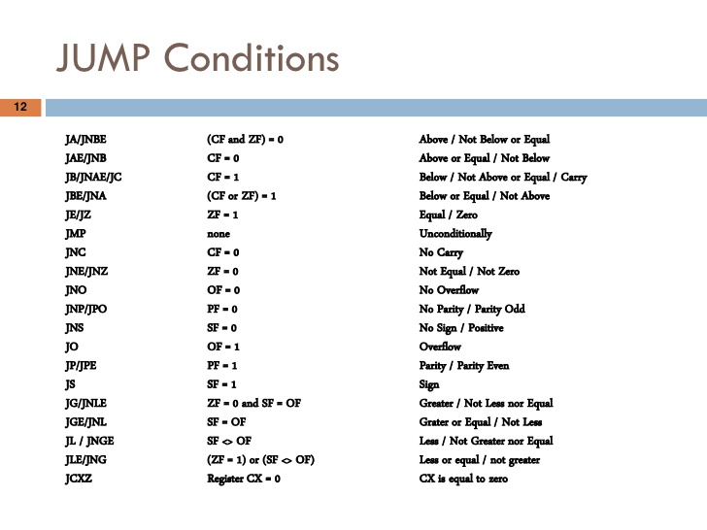
Notes:
ZF=1 ZF=0

Slide 15
Example:
…
Mov al,5
Cmp al,5
Je label1
Jmp exit
Label1:
Mov ax,bx
…
Exit: …

Slide 16
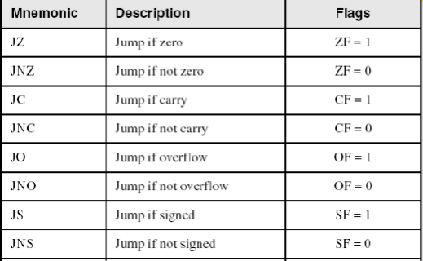
Jumps Based on Flags

Slide 17
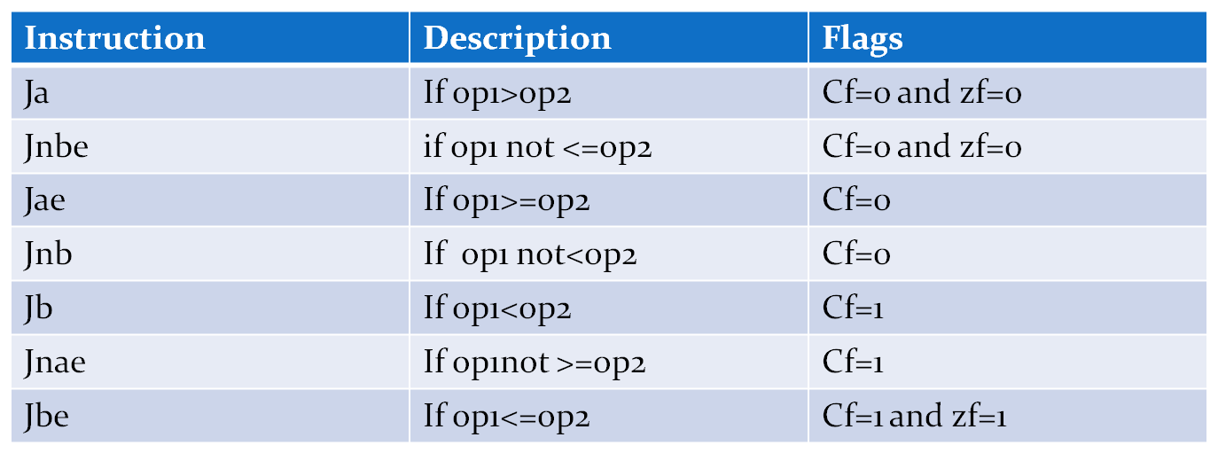
Jumps Based on Conditions

Slide 18
Some Conditional Jumps
Ja – jump if dest above src
Jb – jump if dest below src
Unsigned integers
ZF = 0 and CF = 0
CF = 1

Slide 19
Some Conditional Jumps
Jl – jump if Sdest lower than Ssrc
Jg – jump if dest greater than src
Signed integers
ZF ≠ CF
ZF = 0 and SF = OF

Slide 20
Your turn . . .
Implement the following pseudocode in assembly language. All values are unsigned:
if( bx <= ax
&& cx > dx )
{
ax = 5;
dx = 6;
}
(There are multiple correct solutions to this problem.)

Slide 21
Block-Structured IF Statements
Assembly language programmers can easily translate logical statements written in C++/Java into assembly language. For example:
if( op1 == op2 )
X = 1;
else
X = 2;
mov ax,op1
cmp ax,op2
jne L1
mov X,1
jmp L2
L1:
mov X,2
L2:

Slide 22
Your turn . . .
Implement the following pseudo code in assembly language. All values are 16-bit signed integers:
if( var1 == var2 )
var3 = 10;
else
{
var3 = 6;
var4 = 7;
}
(There are multiple correct solutions to this problem.)

Slide 23

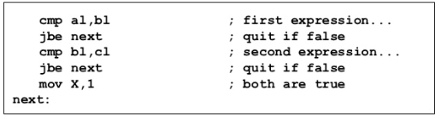
Another Example

Slide 24
And Another
mov ax,var1
cmp ax,var2
je L1
mov var3,6
mov var4,7
jmp L2
L1: mov var3,10
L2:
if( var1 == var2 )
var3 = 10;
else
{
var3 = 6;
var4 = 7;
}

Slide 25
Execution of Another example
;;Assembly language code
mov ax , 15
mov bx , 15
mov cx , 0
cmp ax , bx
jne lable1
mov cx , ax
jmp end
lable1:
mov cx , bx
end:
;;Assembly language code
mov ax , 15
mov bx , 10
mov cx , 0
cmp ax , bx
jne lable1
mov cx , ax
jmp end
lable1:
mov cx , bx
end:

Slide 26
Loop Instruction
CX used as Counter
Automatically Decremented after every iteration
Label is used to jump
Ends when counter reaches zero
Example:
MOV cx,10 ;loop runs 10 times
Loop1:
…
Loop Loop1

Slide 27
WHILE Loops
A WHILE loop is really an IF statement followed by the body of the loop, followed by an unconditional jump to the top of the loop. Consider the following example:
while( ax < bx)
ax = ax + 1;
This is a possible implementation:
top: cmp ax,bx ; check loop condition
jae next ; false? exit loop
inc ax ; body of loop
jmp top ; repeat the loop
next:

Slide 28
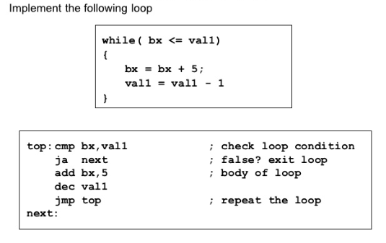
Another Example

